Slide 1


Monitor your Entire Network
from One Place
DISCOVER
2025

Slide 2


QUICK
TO CONFIGURE
Monitoring and Reporting
for Remote Desktop Servers.
2
13
USER FRIENDLY
Understand your Remote Access infrastructure
in detail To Optimize your Production and save
on it costs!
COST-SAVING

Slide 3
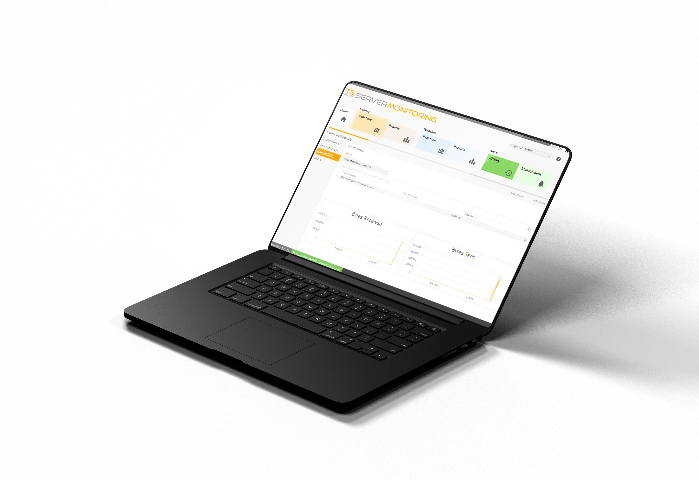
Track Your Server Health in Real-Time
PROCESS & BANDWIDTH
3
Application Usage (Memory, CPU, Bytes/sec)
Network Usage (Bytes/sec)
13

Slide 4
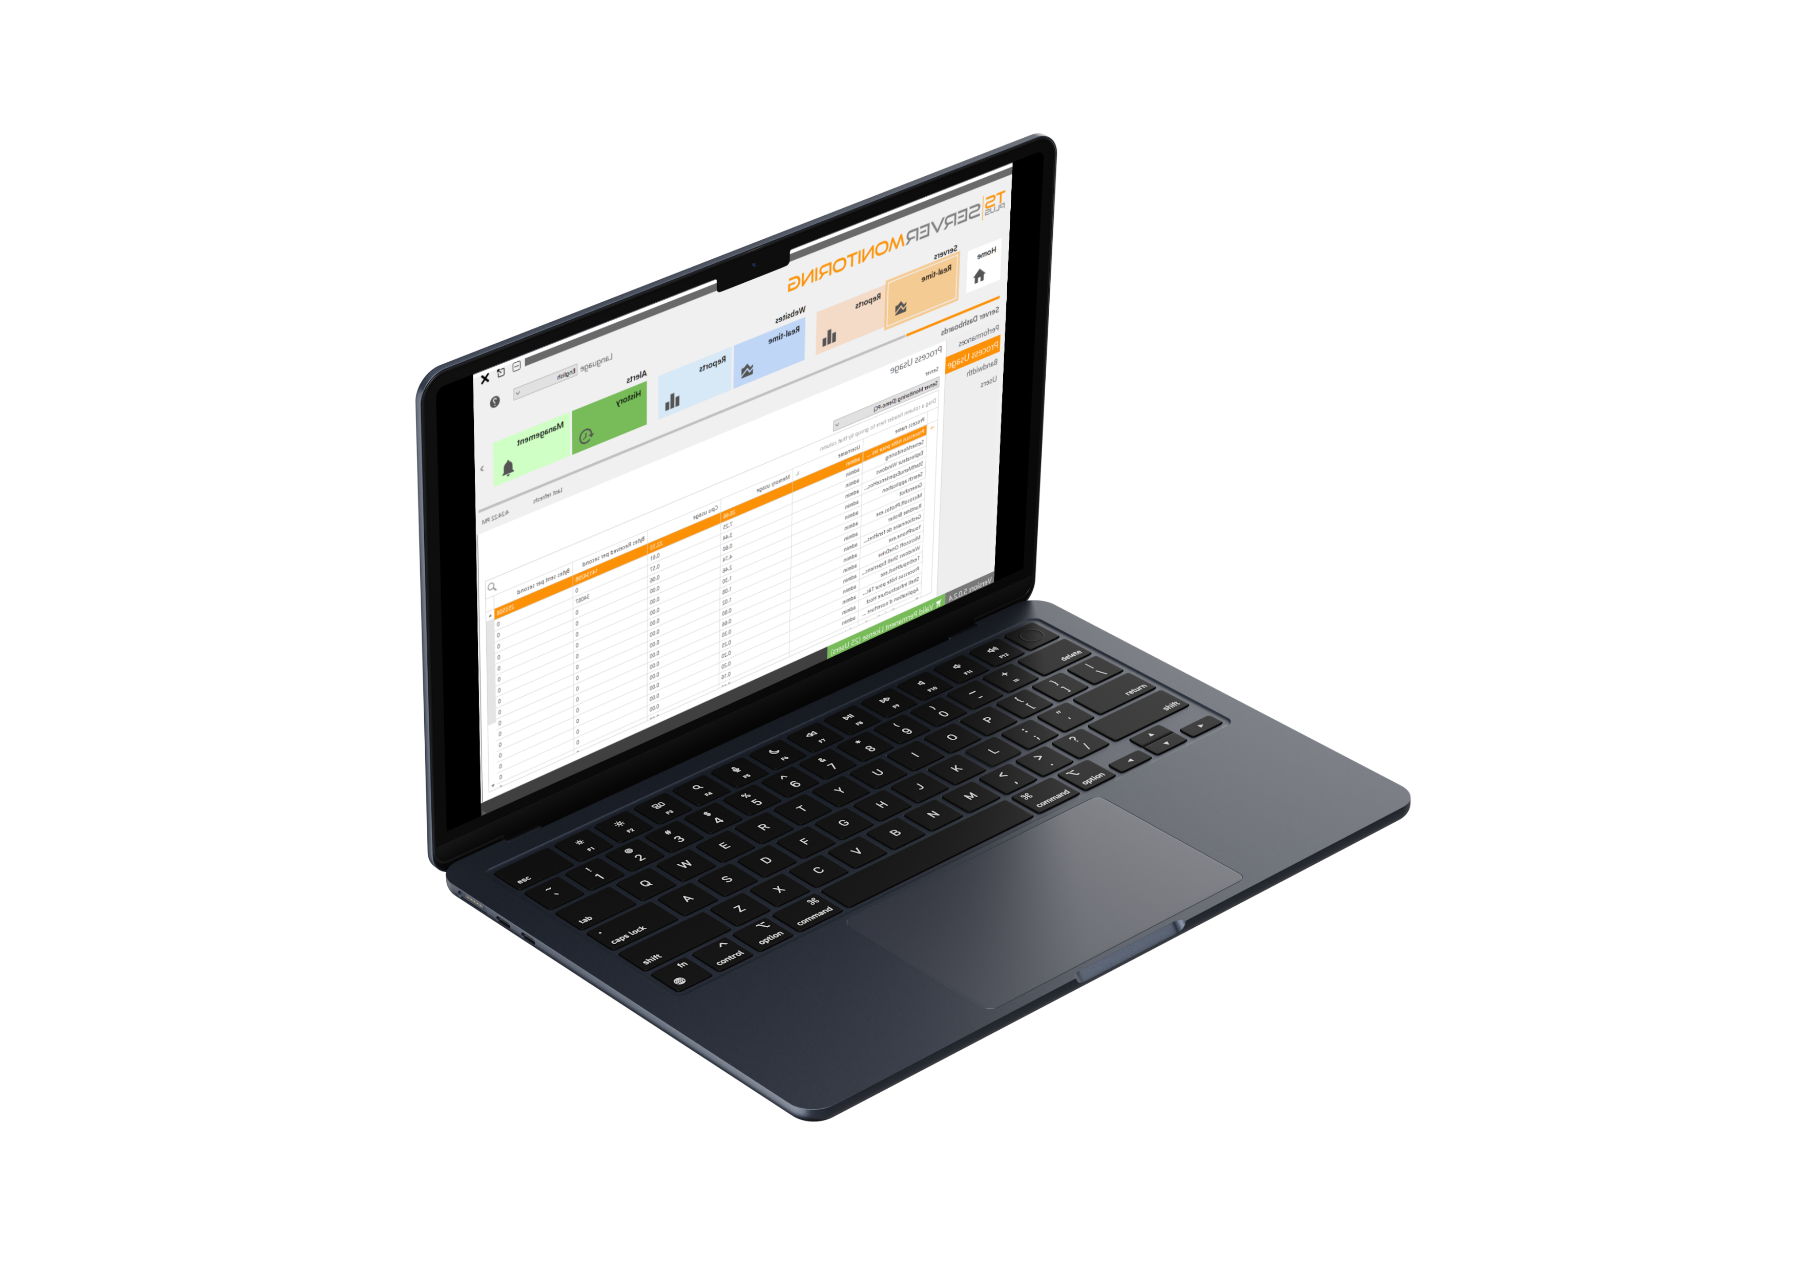
Track Your Server Health in Real-Time
Performance
4
CPU & Memory
Disk Write and Read
13

Slide 5
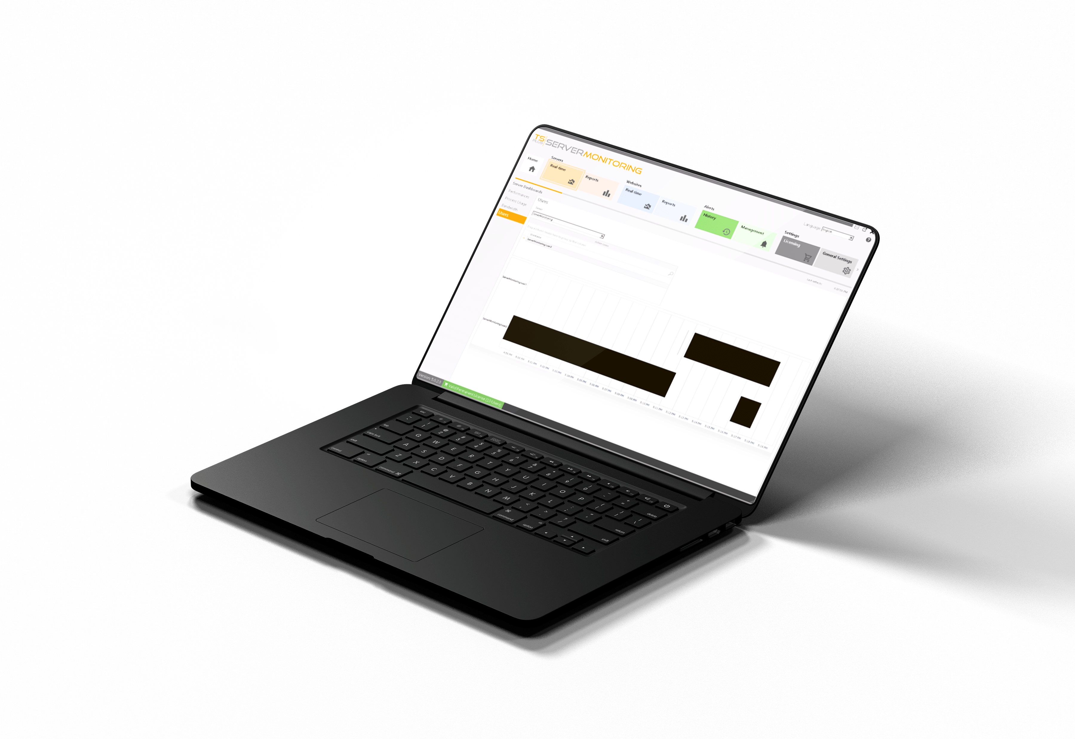
Track Your Server Health in Real-Time
USER BEHAVIOR
5
Active Users/Servers
Session Duration
13

Slide 6
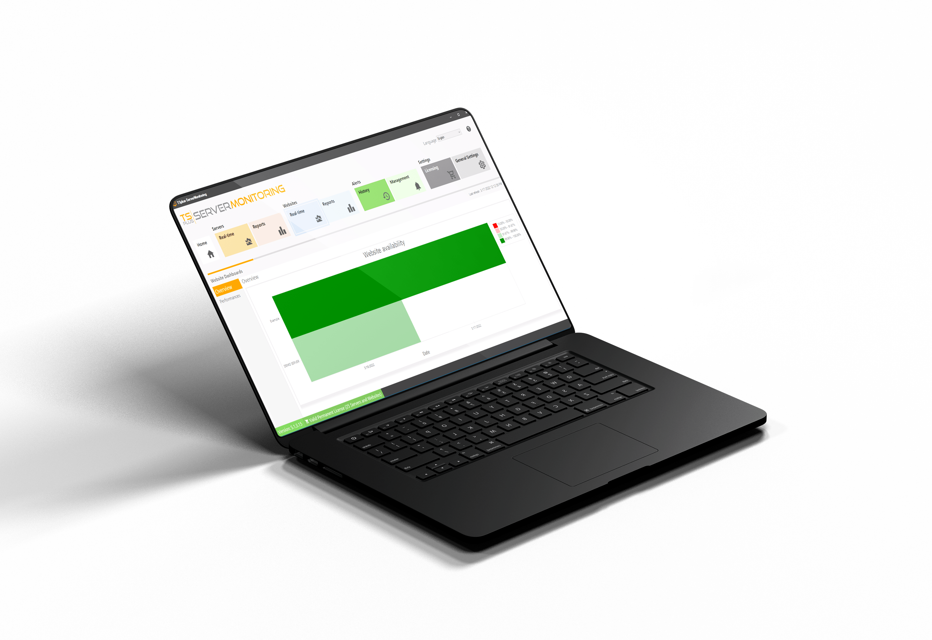
Monitor your Website Activity 24/7
Stay Informed About Your
Website status and Activity
6
AVAILABILITY
13
Up & Down time (%/Day)
Response codes: Green to Red

Slide 7
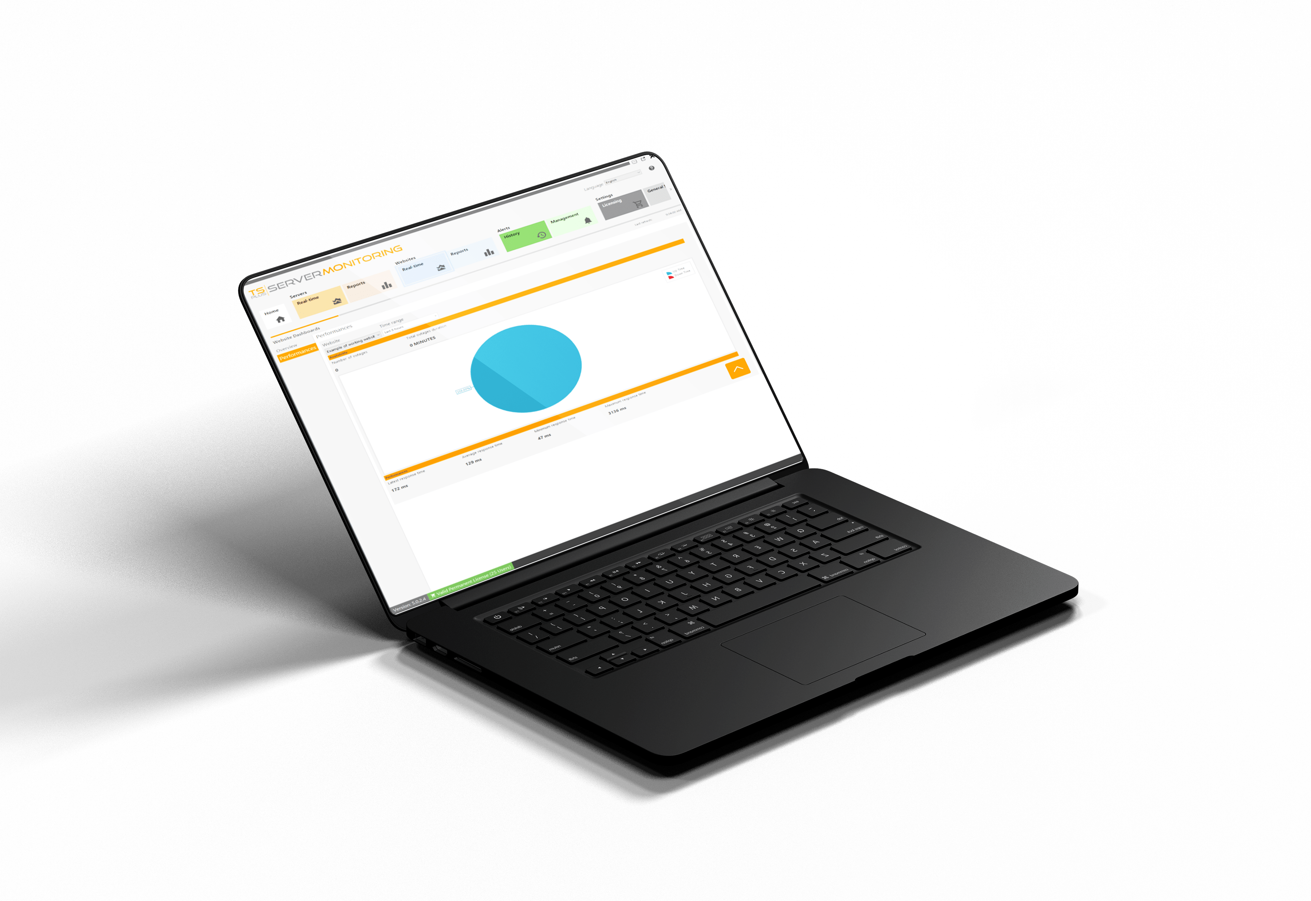
Monitor your Website Activity 24/7
Stay Informed About Your
Website status and Activity
7
PERFORMANCE
13
Number of outages (/Selected Time range)
Total Outage duration

Slide 8
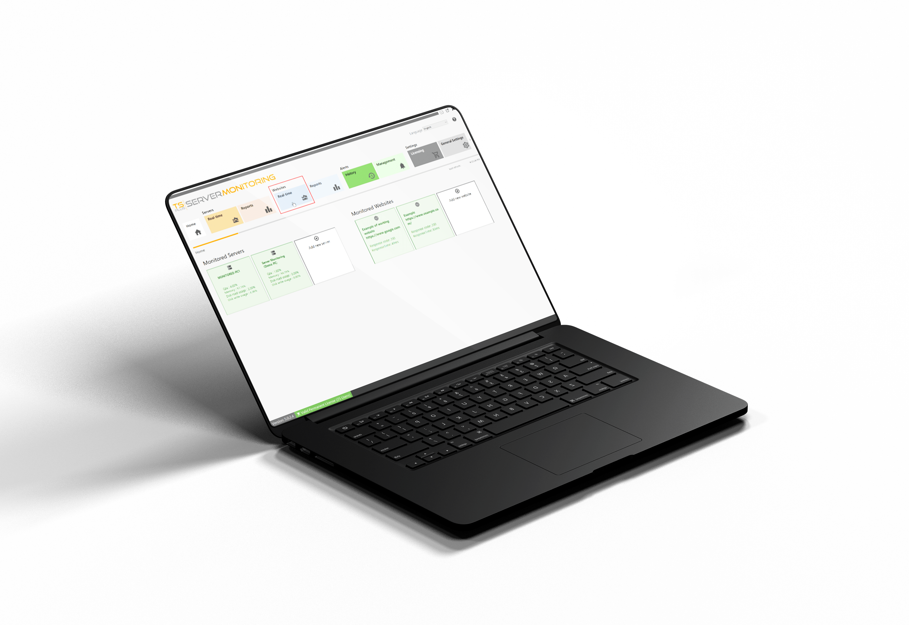
Monitor your Website Activity 24/7
Stay Informed About Your
Website status and Activity
8
RESPONSE TIME
13
Minimum & Maximum
Average Response Time

Slide 9

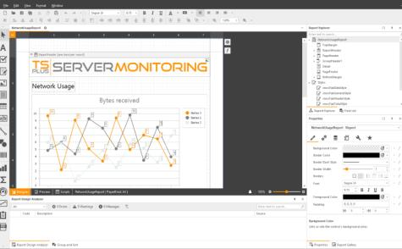

Setup Regular Reporting to Better Manage
your Servers
Easily Create Professional Reports with the Most Relevant Information
9
13
10+ Ready-to-use Reports
Intuitive Customization Tool (logo, brand colors, etc)
Use Real-Time & Historical data
Search, Save, Export and Print Report
Schedule Report Emailing

Slide 10




Receive Real-Time Alerts
on your Network Health
Predict risky situations and troubleshoot issues faster!
10
13
Alert Management Tool
Unlimited Number of Alerts
For Websites, Servers and Users
Customizable Thresholds
Automatic Notifications by email

Slide 11






Server
Performance
User
Activity
Application
Usage
Website
Status
The TSplus Difference: Easy to Setup and Even Easier to Use
11
13
A small agent installed
on each server
Take Full Control of your Remote Infrastructure
Your farm of servers
server administrators
Real-time alerts

Slide 12

Built for You: Flexible Licensing That Grows with Your Strategy!
Our very attractive licensing model starts at:
12
flexible Licensing
PER SERVER PRICING
FREE TRIAL DOWNLOAD
13
$110
for 1 server & 1 website - Perpetual
Or
Mix and match.
Straightforward Cost
15 Days
$5,5
Buy and own your licenses forever or just rent them!
Updates/Support included for a year
1 Server
per server & website - Monthly
Test it Today!
Visit our website

